Slide 1
Guilford County Schools
Parent and Community Surveys
Presentation
January 24, 2015
Prepared By
Nancy Burnap, Ph.D
Research Strategies, Inc.
Presented By
Nora Carr
Chief of Staff
Guilford County Schools
Research Strategies, Inc.

Slide 2
Research Objectives
The primary objectives of this research are to measure:
  Most important issues and concerns related to GCS
  Performance and perceptions of GCS*
  Performance and perceptions of GCS schools*
  Performance and perceptions of GCS programs and services*
  Performance and perceptions of GCS and school-based communications*
  Preferred/most credible sources of information about GCS**
  Awareness and usefulness of various communications
  tools and platforms**
  *Represents strategic plan measures
  **Represents measures used for planning purposes and to improve school and district communications

Slide 3
Methodology
Two telephone surveys conducted by Research Strategies, Inc.
Community Residents (September 28 - October 7, 2014)
  408 interviews
  Random selection of Guilford County adults
  Random sample with landline and cell phone numbers
  Average interview length: 9 minutes
Parent Survey (October 12 - October 23, 2014)
411 interviews completed
Random sample from list provided by GCS
Average interview length: 20 minutes
Margin of error for each study: + 5% at the 95% confidence level

Slide 4
Representativeness of Samples
Comparison of Actual vs. Sample Percentages
on Key Demographics
 | GCS Actual 2014 | Parent Sample 2014
Race/Ethnicity
White | 35% | 35%
African American | 42% | 41%
Hispanic, Latino | 14% | 14%
Other | 9% | 10%
 | Projected Census Data 2014 | Community Sample 2014
Race/Ethnicity
White | 53% | 59%
African American | 34% | 31%
Hispanic, Latino | 8% | 6%
Other | 5% | 4%
Age (% of Adults)
18-34 | 31% | 31%
35-44 | 18% | 19%
45-54 | 18% | 19%
55-64 | 15% | 16%
65+ | 17% | 16%
Gender
Male | 48% | 48%
Female | 52% | 52%
The Community and Parent samples are representative based on key demographics.
Notes:
4

Slide 5
Most Important Issues Related
To Guilford County Public Schools (Q9)
Parent & Community Perceptions
(Open-ended, comment question. Up to three answers allowed.)
Parents (n=411)
Community (n=408)
The top four issues for parents and community residents are: class size, good teachers, teacher pay, and safety.
Last year, safety was the top issue and was mentioned much more often than any other issue (30% for parents and 34% for community residents.)

Slide 6
Performance of GCS (Q71-83)
Parent & Community Perceptions
Average Ratings on 10-Point Scale
Don’t know responses dropped from base.
Total Samples Scale: 1=Very poor to 10=Very good | Parents | Community
Teachers | 8.3 | 7.9
Principals | 8.2 | 7.5
Overall quality of education | 8.2 | 7.2
Support staff | 8.2 | 7.3
Superintendent Mo Green | 8.1 | 7.3
Regional Superintendents | 7.8 | 7.0
Central Office Administrators | 7.8 | 6.9
Board of Education | 7.5 | 6.8
Blue highlighting indicates that parents give GCS significantly higher performance ratings than community residents, on all areas except teachers.
The majority of parents and community residents give ratings of good or very good (ratings of 7 to 10) on all these areas.
The Board of Education receives the lowest ratings, with 74% of parents and 63% of community residents giving ratings of 7 to 10.
Notes:
6

Slide 7
Ratings on Quality of Schools (Q71-83)
Parent & Community Perceptions
Average Ratings on 10-Point Scale
Don’t know responses dropped from base.
Total Samples Scale: 1=Very poor to 10=Very good | Parents | Community
Quality of GCS magnet schools | 8.6 | 7.9
Quality of GCS choice or option schools | 8.3 | 7.2
Quality of GCS traditional schools | 8.0 | 7.1
Quality of charter schools (Not GCS) | 7.6 | 6.7
The majority of parents and community residents rate all the types of schools good or very good (ratings of 7 to 10).
Parents give higher ratings than community residents.
Parents rate GCS schools higher than charter schools.
Community residents rate magnet schools higher than other types of schools.
Blue highlighting shows that more community residents, than parents, can rate charter schools.
Total Samples | Percent of Parents Able to Rate | Percent of Community Able to Rate
Quality of GCS magnet schools | 62% | 68%
Quality of GCS choice or option schools | 52% | 49%
Quality of GCS traditional schools | 91% | 93%
Quality of charter schools (Not GCS) | 33% | 42%
Notes:
7

Slide 8
Level of Agreement with Statements
About the Performance of GCS (Q86-Q91)
Parent & Community Perceptions
(Average ratings on 10-point scale)
Don’t know responses dropped from base.
Total Samples Scale: 1=Strongly Disagree to 10=Strongly Agree | Parents | Community
GCS keeps you informed | 8.6 | 7.3
GCS schools are safe | 8.2 | 7.1
GCS is doing a good job | 8.1 | 7.2
The GCS system is headed in the right direction | 8.0 | 7.1
GCS is responsive to requests | 8.0 | 6.9
GCS does a good job using taxpayer money to educate children | 7.1 | 6.3
Blue highlighting shows that parents agree more strongly with the statements, than community residents.
The majority of parents and community residents agree with all of the statements.
  Use of taxpayer money receives the lowest ratings, with 67% of parents and 58% of community residents giving ratings of 7 or higher.
Notes:
8

Slide 9
Level of Agreement with Statements
About the Performance of GCS (Q63-Q69b)
Parent Perceptions
(Average ratings on 10-point scale)
Don’t know responses dropped from base.
Scale: 1=Disagree strongly to 10=Agree Strongly | Average Rating
I believe my child’s school is safe. | 8.6
I believe my child is academically challenged. | 8.5
I believe my child’s school supports the development of good character. | 8.5
GCS has good academic programs for college-bound students. | 8.4
By offering traditional schools, magnet schools, and choice or option schools, GCS gives enough school choices to meet my child’s needs. | 8.4
I believe my child’s school has high quality teachers. | 8.3
GCS has good career and technical education programs. | 8.2
GCS schools are safe | 8.2
GCS has good programs for students interested in music, visual and performing arts | 8.1
GCS has good programs for students who require extra help or special education | 7.8
The majority of parents agree (ratings of 7 to 10) with all the statements.
Blue highlighting shows that parents rate the safety of their child’s school higher than GCS schools overall (8.6 vs. 8.2).

Slide 10
Level of Agreement with Statements (Q61-Q62)
Parent Perceptions
Average Ratings on 10-Point Scale
Don’t know responses dropped from base.
Scale: 1=Disagree strongly to 10=Agree Strongly | % Rating 9 or 10 | Average Rating
I plan to re-enroll my child in a GCS school next year. | 85% | 9.1
I would recommend my child’s GCS school to others. | 74% | 8.8

Slide 11
Top Sources for Learning About GCS
System-Wide Issues (Q10)
Parent & Community Perceptions
(Open-ended, comment question. Multiple answers allowed.)
Parents (n=411)
Community, (n=408)
Among parents, the top four sources of communication are controlled by GCS.
Among community residents, the top two sources are mass media.

Slide 12
Television Station Watched Most For News
About Guilford County Public Schools (Q11)
Parent & Community Perceptions
Parents (n=411)
Community (n=408)
No difference among these.

Slide 13
GCS TV (Q12-17)
Parent Perceptions
61% of parents subscribe to Time Warner Cable TV or AT&T U-verse.
Among parents who subscribe:
67% are aware of GCS TV.
39% watch GCS TV.
Usage declined (62% to 39%).
Usage is higher among African American parents (47%), than white parents (30%). (Sample size for Latinos is too small for analysis.)
Among parents who use GCS TV:
81% give a usefulness rating of 7 or higher.
Usefulness improved (average ratings of 6.1 to 7.6).
Usefulness ratings are higher among African American parents, than white parents (74% vs. 60% give ratings of 7 to 10).
Awareness of GCS TV online increased (24% to 37%).
Parent Ratings of
Usefulness of GCS TV
(Parents who use GCS TV, n= 97)
Don’t know responses dropped from base.
Average usefulness rating = 7.6

Slide 14
App for GCS News & Information (Q19-20)
Parent Perceptions
Parent ratings of usefulness of app for general news & information about GCS (Q19)
(Smartphone or Tablet Users, n=327)
Don’t know responses dropped from base.
92% of parents have access to the Internet.
  Access is higher among white parents (97%) and African American parents (92%), than Latino parents (78%).
82% of parents access the Internet using a smartphone or tablet computer.
Access is higher among white parents (87%) and African American parents (80%), than Latino parents (71%).
Among parents with a smartphone or tablet:
82% give a usefulness rating of 7 or higher.
Regardless of race/ethnicity, at least 74% believe the app would be useful.
Use of social media to get news and information about GCS increased (23% to 41%).
Average usefulness rating = 8.2

Slide 15
District Website
Parent Perceptions (Q24-26)
Parent Ratings of Usefulness of
District Website
(Parents who have been to Website, n=235)
Don’t know responses dropped from base.
77% of parents with Internet access are aware of the District Website.
63% of parents use the District Website.
Usage decreased (74% to 63%).
Usage is higher among white parents (88%) and African American parents (70%), than Latino parents (56%).
Among parents who use the District Website:
78% give a usefulness rating of 7 or higher.
Regardless of race/ethnicity, at least 70% give a rating of 7 or higher.
Average usefulness rating = 7.8

Slide 16
Individual School Websites (Q27-29)
Parent Perceptions
Among parents with Internet access:
87% are aware of individual school websites.
77% use an individual school website.
Usage decreased (83% to 77%), but remains high.
Usage is higher among white parents (88%) and African American parents (70%), than Latino parents (56%).
82% of parents who use an individual school website, give a usefulness rating of 7 or higher.
Parent Ratings of Usefulness of
Individual School Websites
(Parents who have been to Website, n=291)
Don’t know responses dropped from base.
Average usefulness rating = 8.0

Slide 17
District Office Communication (Q30-32)
Parent Perceptions
Don’t know responses dropped from base
Average Rating = 8.0
Average Rating = 7.8
Among parents:
80% rate the District Office a 7 or higher on keeping them informed about system-wide issues.
24% have contacted the District Office with requests for information.
81% who contacted the District Office rate the responsiveness a 7 or higher.

Slide 18
Regional Office Communication (Q33-34)
Parent Perceptions
Don’t know responses dropped from base
Average rating = 8.4
Among parents:
22% have contacted a regional office with requests for information.
91% who contacted a regional office rate the responsiveness a 7 or higher.

Slide 19
Individual School Communication (Q35-37)
Parent Perceptions
Don’t know responses dropped from base
Average Rating = 8.6
Average Rating = 8.2
Among parents:
66% have contacted their child’s individual school with requests for information.
The percentage who contacted schools has declined (79% to 66%).
89% rate schools a 7 or higher on keeping them informed.
86% who contacted schools rate the responsiveness a 7 or higher.

Slide 20
Satisfaction with Other Areas of Communication (Q38-Q57)
Parent Perceptions
Average Ratings on 10-Point Scale
Scale: 1=Very dissatisfied to 10=Very Satisfied | Average Rating
How well child is performing in school | 8.4
How to get involved with child's school | 8.3
The safety of your child's school | 8.0
Bus transportation | 7.9
How well child's school is performing compared to other schools in the county | 7.7
Curriculum offerings | 7.7
Programs for gifted students | 7.7
Magnet schools, choice or option schools | 7.7
Child nutrition or school lunch | 7.6
School selections & student assignments | 7.6
Different schools in the system | 7.6
After-school care | 7.5
Athletic opportunities | 7.5
Character education | 7.4
Community service & service learning opportunities | 7.4
Counselors and guidance | 7.3
College preparation | 7.3
Career/technical education or career preparation | 7.3
Special programs for students needing help | 7.1
Study abroad opportunities | 6.7
New school construction & renovations | 6.4
The majority of parents (able to rate) give ratings of 7 to 10 on all the areas measured.
Note: Don’t know responses dropped from base.

Slide 21
Guilford Parent Academy (Q58-Q60)
Parent Perceptions
Performance of
Guilford Parent Academy
(Parents who have participated in Parent Academy, n=63)
Don’t know responses dropped from base.
75% of parents are aware of Guilford Parent Academy.
16% of parents in poll have participated in programs.
Participation is higher among African American parents (21%), than white parents (13%) or Latino parents (7%).
95% of those who have participated rate the programs a 7 or higher.
Average rating = 8.5

Slide 22
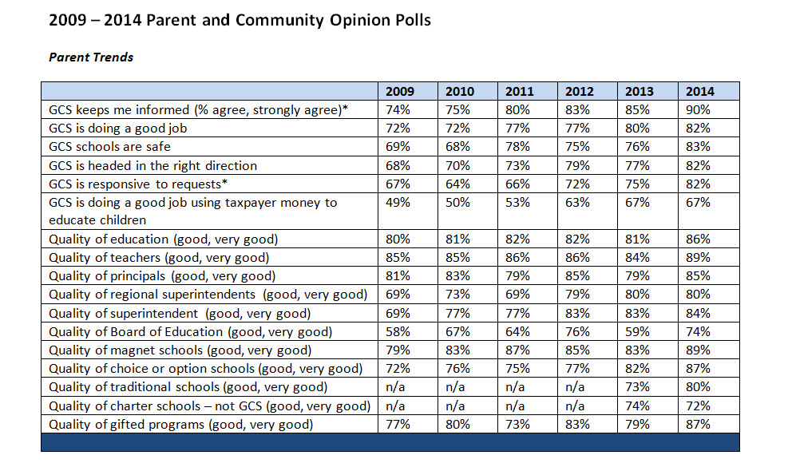
2009 – 2014 Parent Trends by %

Slide 23
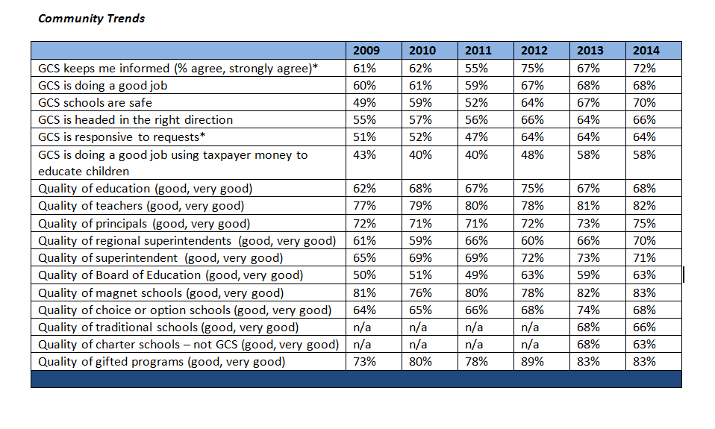
2009 – 2014 Community Trends by %

